Slide 1

Machine Learning & Data Mining CS/CNS/EE 155
Lecture 2:
Review Part 2

Slide 2
Recap: Basic Recipe
Training Data:
Model Class:
Loss Function:
Learning Objective:
Linear Models
Squared Loss
Optimization Problem

Slide 3
Recap: Bias-Variance Trade-off
Bias
Variance
Bias
Variance
Bias
Variance

Slide 4

Recap: Complete Pipeline
Training Data
Model Class(es)
Loss Function
Cross Validation & Model Selection
Profit!

Slide 5
Today
Beyond Linear Basic Linear Models
Support Vector Machines
Logistic Regression
Feed-forward Neural Networks
Different ways to interpret models
Different Evaluation Metrics
Hypothesis Testing

Slide 6
Squared Loss
How to compute
gradient for 0/1 Loss?
Loss
0/1 Loss
Target y
f(x)

Slide 7
Recap: 0/1 Loss is Intractable
0/1 Loss is flat or discontinuous everywhere
VERY difficult to optimize using gradient descent
Solution: Optimize smooth surrogate Loss
Today: Hinge Loss (…eventually)

Slide 8
Support Vector Machines aka Max-Margin Classifiers

Slide 9
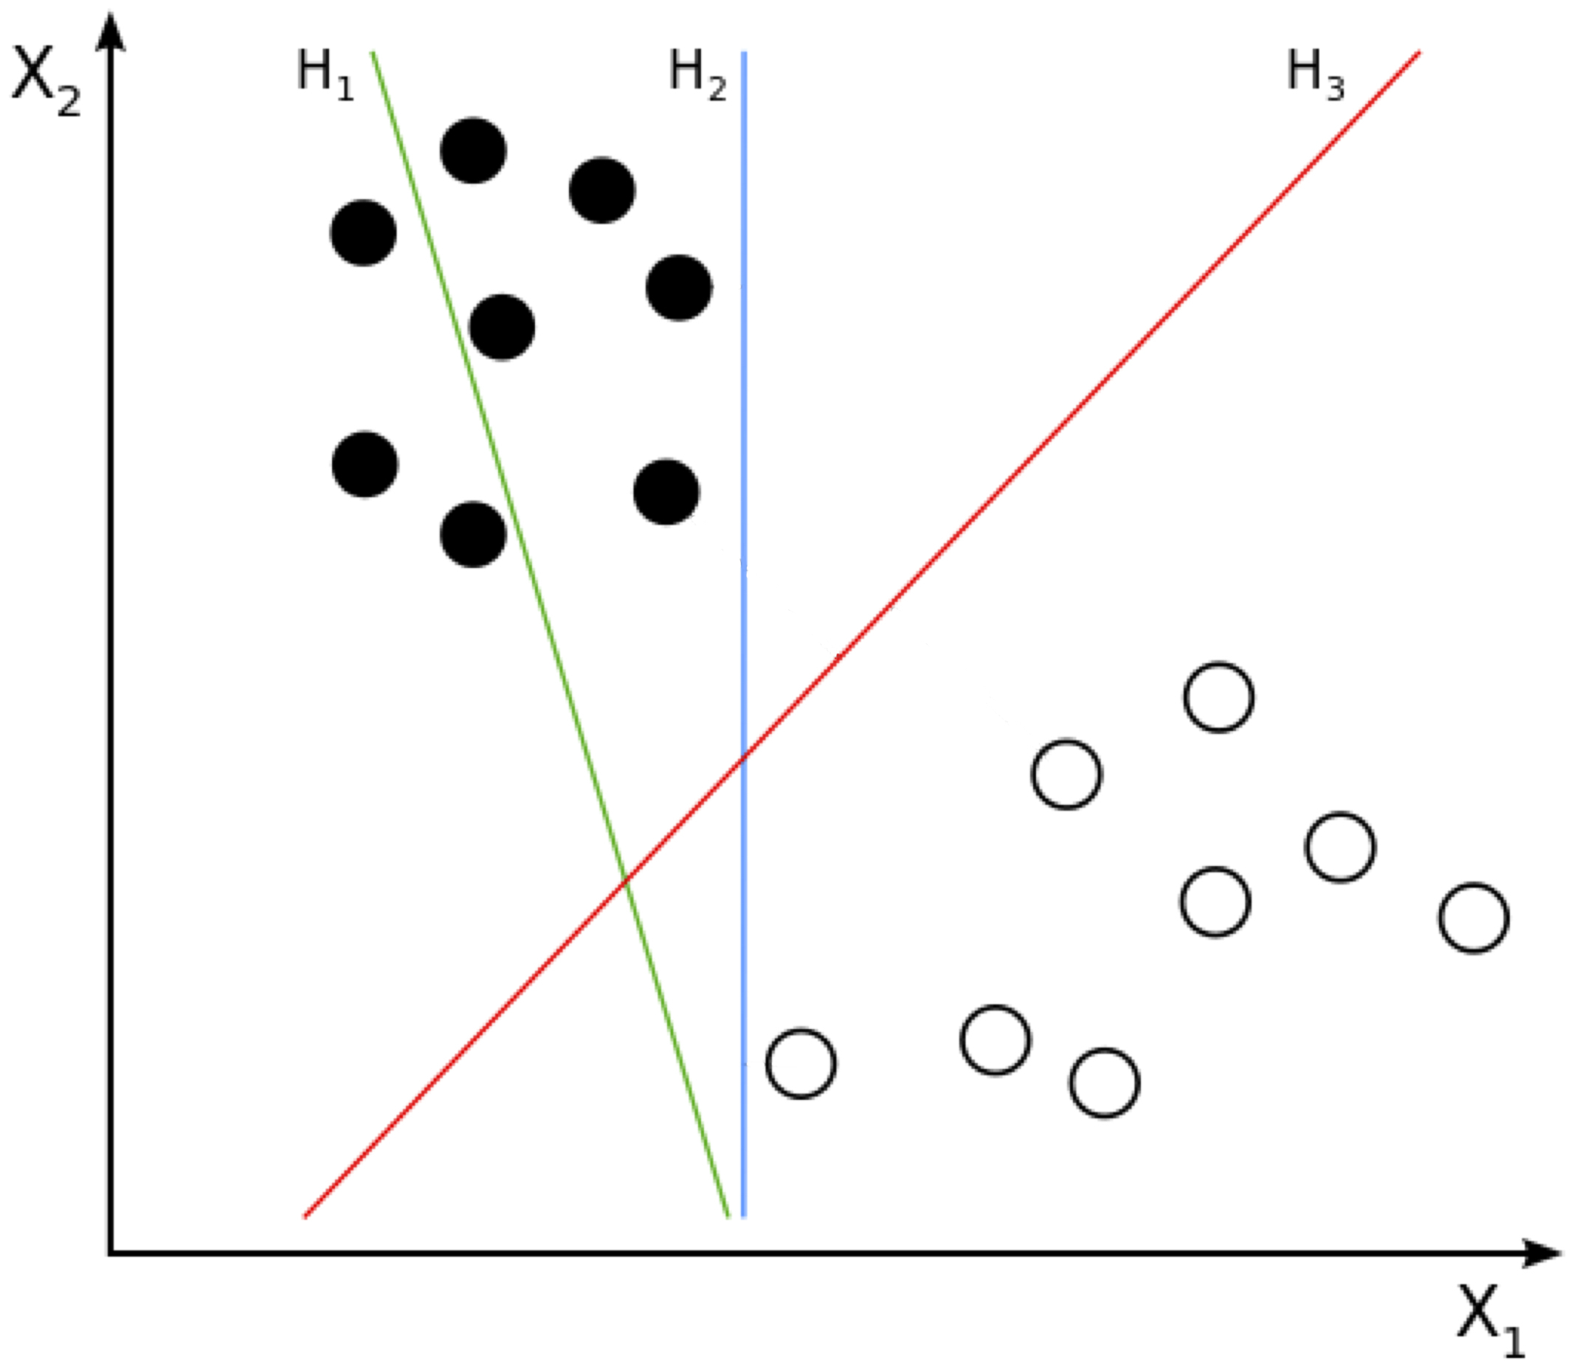
Which Line is the Best Classifier?
Source: http://en.wikipedia.org/wiki/Support_vector_machine

Slide 10
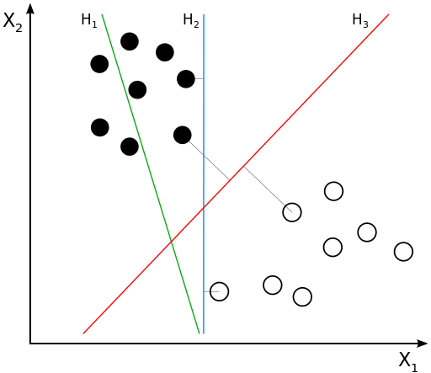
Which Line is the Best Classifier?
Source: http://en.wikipedia.org/wiki/Support_vector_machine

Slide 11
Hyperplane Distance
Line is a 1D, Plane is 2D
Hyperplane is many D
Includes Line and Plane
Defined by (w,b)
Distance:
Signed Distance:
w
b/|w|
Linear Model =
un-normalized
signed distance!

Slide 12
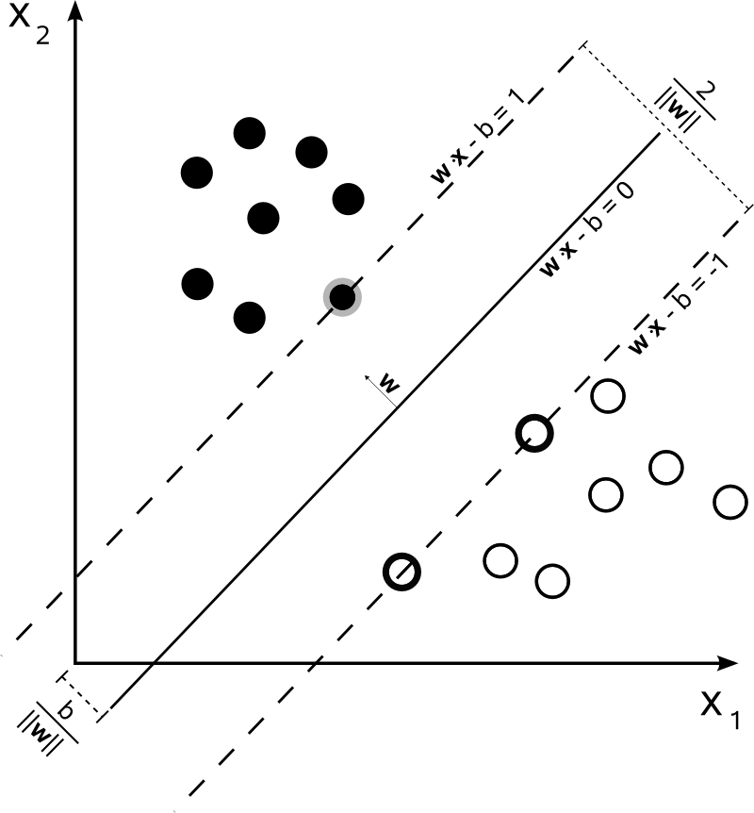
Max Margin Classifier (Support Vector Machine)
“Margin”
Better generalization
to unseen test examples
(beyond scope of course*)
“Linearly Separable”
*http://olivier.chapelle.cc/pub/span_lmc.pdf
Image Source: http://en.wikipedia.org/wiki/Support_vector_machine

Slide 13
Soft-Margin Support Vector Machine
“Margin”
Size of Margin
vs
Size of Margin Violations
(C controls trade-off)
Image Source: http://en.wikipedia.org/wiki/Support_vector_machine

Slide 14
Hinge Loss
Regularization
Hinge Loss
Loss
Target y
0/1 Loss
f(x)

Slide 15
Hinge Loss vs Squared Loss
Squared Loss
Hinge Loss
Loss
0/1 Loss
Target y
f(x)

Slide 16
Support Vector Machine
2 Interpretations
Geometric
Margin vs Margin Violations
Loss Minimization
Model complexity vs Hinge Loss
Equivalent!

Slide 17
Logistic Regression aka “Log-Linear” Models

Slide 18
Logistic Regression
P(y|x)
y*f(x)
“Log-Linear” Model
Also known as sigmoid function:

Slide 19
Maximum Likelihood Training
Training set:
Maximum Likelihood:
(Why?)
Each (x,y) in S sampled independently!
See recitation next Wednesday!

Slide 20
Why Use Logistic Regression?
SVMs often better at classification
At least if there is a margin…
Calibrated Probabilities?
Increase in SVM score….
...similar increase in P(y=+1|x)?
Not well calibrated!
Logistic Regression!
P(y=+1)
f(x)
*Figure above is for
Boosted Decision Trees
(SVMs have similar effect)
Image Source: http://machinelearning.org/proceedings/icml2005/papers/079_GoodProbabilities_NiculescuMizilCaruana.pdf

Slide 21
Log Loss
Log Loss
Solve using
Gradient Descent

Slide 22
Log Loss vs Hinge Loss
Hinge Loss
Loss
Log Loss
0/1 Loss
f(x)

Slide 23
Logistic Regression
Two Interpretations
Maximizing Likelihood
Minimizing Log Loss
Equivalent!

Slide 24
Feed-Forward Neural Networks aka Not Quite Deep Learning

Slide 25
1 Layer Neural Network
1 Neuron
Takes input x
Outputs y
~Logistic Regression!
Gradient Descent
x
Σ
y
“Neuron”
f(x|w,b) = w^{T}x – b
= w₁*x₁ + w₂*x₂ + w₃*x₃ – b
y = σ( f(x) )
sigmoid
tanh
rectilinear

Slide 26
2 Layer Neural Network
Σ
x
Σ
y
Σ
Hidden Layer
2 Layers of Neurons
1st Layer takes input x
2nd Layer takes output of 1st layer
Can approximate arbitrary functions
Provided hidden layer is large enough
“fat” 2-Layer Network
Non-Linear!

Slide 27
Aside: Deep Neural Networks
Why prefer Deep over a “Fat” 2-Layer?
Compact Model
(exponentially large “fat” model)
Easier to train?
Image Source: http://blog.peltarion.com/2014/06/22/deep-learning-and-deep-neural-networks-in-synapse/

Slide 28
Training Neural Networks
Gradient Descent!
Even for Deep Networks*
Parameters:
(w₁₁,b₁₁,w₁₂,b₁₂,w₂,b₂)
Σ
x
Σ
y
Σ
f(x|w,b) = w^{T}x – b
y = σ( f(x) )
Backpropagation = Gradient Descent
(lots of chain rules)
*more complicated

Slide 29
Today
Beyond Linear Basic Linear Models
Support Vector Machines
Logistic Regression
Feed-forward Neural Networks
Different ways to interpret models
Different Evaluation Metrics
Hypothesis Testing

Slide 30
Evaluation
0/1 Loss (Classification)
Squared Loss (Regression)
Anything Else?

Slide 31
Example: Cancer Prediction
Patient
Loss Function | Has Cancer | Doesn’t Have Cancer
Predicts Cancer | Low | Medium
Predicts No Cancer | OMG Panic! | Low
Model
Value Positives & Negatives Differently
Care much more about positives
“Cost Matrix”
0/1 Loss is Special Case

Slide 32
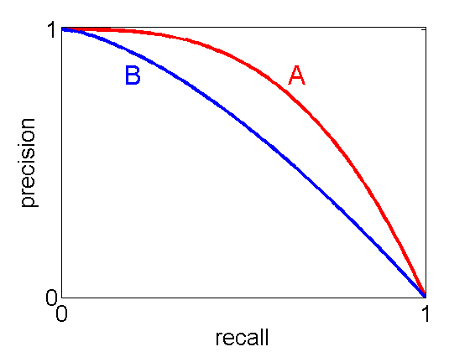
Precision & Recall
Precision = TP/(TP + FP)
Recall = TP/(TP + FN)
TP = True Positive, TN = True Negative
FP = False Positive, FN = False Negative
F1 = 2/(1/P+ 1/R)
Care More About Positives!
Patient
Counts | Has Cancer | Doesn’t Have Cancer
Predicts Cancer | 20 | 30
Predicts No Cancer | 5 | 70
Model
Image Source: http://pmtk3.googlecode.com/svn-history/r785/trunk/docs/demos/Decision_theory/PRhand.html

Slide 33
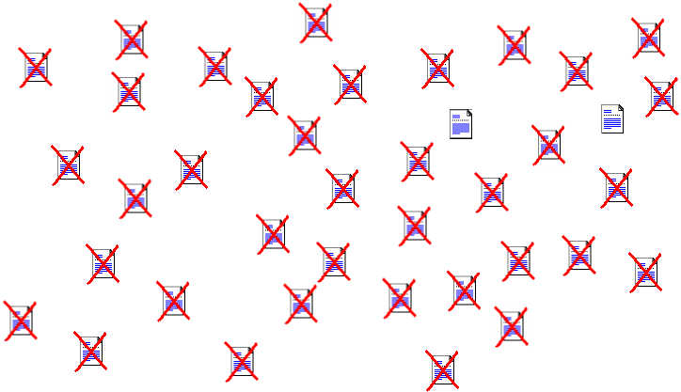
Example: Search Query
Rank webpages by relevance

Slide 34
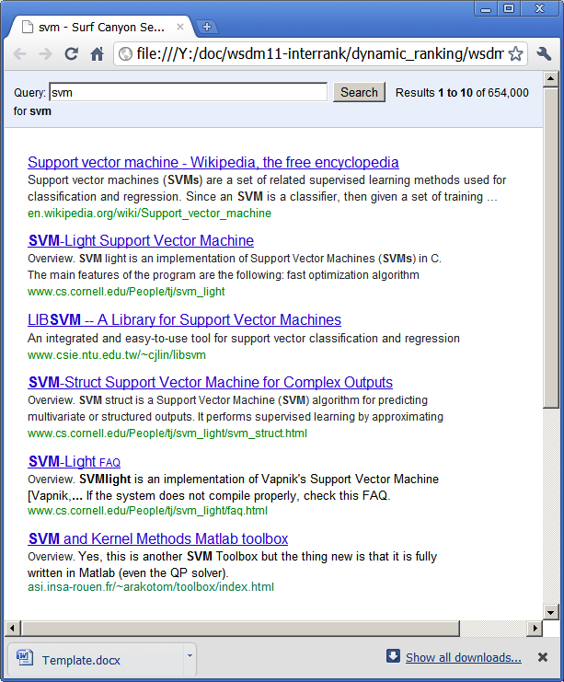


Ranking Measures
Predict a Ranking (of webpages)
Users only look at top 4
Sort by f(x|w,b)
Precision @4 =1/2
Fraction of top 4 relevant
Recall @4 =2/3
Fraction of relevant in top 4
Top of Ranking Only!
Top 4
Image Source: http://pmtk3.googlecode.com/svn-history/r785/trunk/docs/demos/Decision_theory/PRhand.html

Slide 35
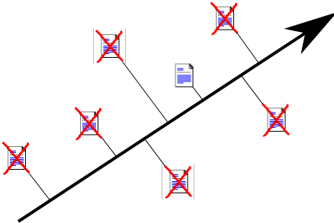
Pairwise Preferences
2 Pairwise Disagreements
4 Pairwise Agreements

Slide 36
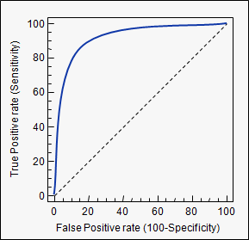

ROC-Area & Average Precision
ROC-Area
Area under ROC Curve
Fraction pairwise agreements
Average Precision
Area under P-R Curve
P@K for each positive
Example:
ROC-Area: 0.5
AP:
Image Source: http://pmtk3.googlecode.com/svn-history/r785/trunk/docs/demos/Decision_theory/PRhand.html
http://www.medcalc.org/manual/roc-curves.php

Slide 37
Summary: Evaluation Measures
Different Evaluations Measures
Different Scenarios
Large focus on getting positives
Large cost of mis-predicting cancer
Relevant webpages are rare

Slide 38
Today
Beyond Linear Basic Linear Models
Support Vector Machines
Logistic Regression
Feed-forward Neural Networks
Different ways to interpret models
Different Evaluation Metrics
Hypothesis Testing

Slide 39
Uncertainty of Evaluation
Model 1: 0.22 Loss on Cross Validation
Model 2: 0.25 Loss on Cross Validation
Which is better?
What does “better” mean?
True Loss on unseen test examples
Model 1 might be better…
...or not enough data to distinguish

Slide 40
Uncertainty of Evaluation
Model 1: 0.22 Loss on Cross Validation
Model 2: 0.25 Loss on Cross Validation
Validation set is finite
Sampled from “true” P(x,y)
So there is uncertainty

Slide 41
Uncertainty of Evaluation
Model 1: 0.22 Loss on Cross Validation
Model 2: 0.25 Loss on Cross Validation
Model 1 Loss:
-0.6279 -0.9001 2.7460 1.8755 0.5275 -1.0371 -0.6455 0.0435 1.0114 -1.1120 -2.1099 -1.2291 0.5535 0.6114 0.6717 0.0897 0.4037 -0.2562 1.0820 -1.1417 0.6750 -0.6287 -0.1149 0.7728 1.2591 -0.8976 1.4807 0.8801 0.1521 0.0248 0.0024 -0.0831 0.2430 0.2713 1.0461 1.7470 0.6869 0.0103 0.8452 0.4032 -0.8098 1.1692 0.5271 0.3552 0.7352 0.4814 -0.7215 0.0577 0.0739 -0.2000
Model 2 Loss:
0.1251 1.7290 -0.6108 1.0347 0.5586 0.0161 -0.8070 -0.0341 0.1633 -1.2194 0.4422 -0.5723 0.1558 0.5862 -0.6547 -0.0383 0.6001 -1.5859 1.2860 2.6745 1.2094 -0.0658 0.6786 -0.7860 2.1279 1.1907 1.0373 -0.6259 0.5699 -0.3083 -0.0614 -0.3200 -0.7757 -0.6587 0.0401 -1.4489 0.8576 0.1322 0.9492 0.5196 0.7443 -1.2331 -0.7703 -0.1970 0.3597 1.3787 -0.0400 1.5116 0.9504 1.6843

Slide 42
Gaussian Confidence Intervals
Model 1
Model 2
50 Points
Points
1000 Points
Points
25000 Points
See Recitation Next Wednesday!

Slide 43
Next Week
Regularization
Lasso
Recent Applications
Next Wednesday:
Recitation on Probability & Hypothesis Testing

